Slide 1
Terrorism Data Analysis (1970-2017)
An In-Depth Analysis of Global Terrorism Trends

Slide 2

Introduction
This analysis is based on a dataset recording global terrorist activities from 1970 to 2017. The dataset includes information on the number of attacks, fatalities, weapon types used, and the regions affected by terrorism. This presentation aims to uncover key trends and insights through various data visualizations.

Slide 3
Objectives
The main objectives of this analysis are:
1. To identify trends in the number of terrorist attacks over time.
2. To analyze the correlation between the number of attacks and fatalities.
3. To explore the distribution of weapon types used in terrorist attacks.
4. To provide insights into the impact of terrorism across different regions.

Slide 4
Exploratory Data Analysis (EDA)
During the initial exploration of the dataset, the following observations were made:
1. The data spans from 1970 to 2017, covering over 80,000 terrorist incidents globally.
2. The dataset contains information on attack types, weapon types, the number of fatalities and wounded, and regional distribution.
3. Certain columns had missing or inconsistent data, which were cleaned and prepared for analysis.

Slide 5
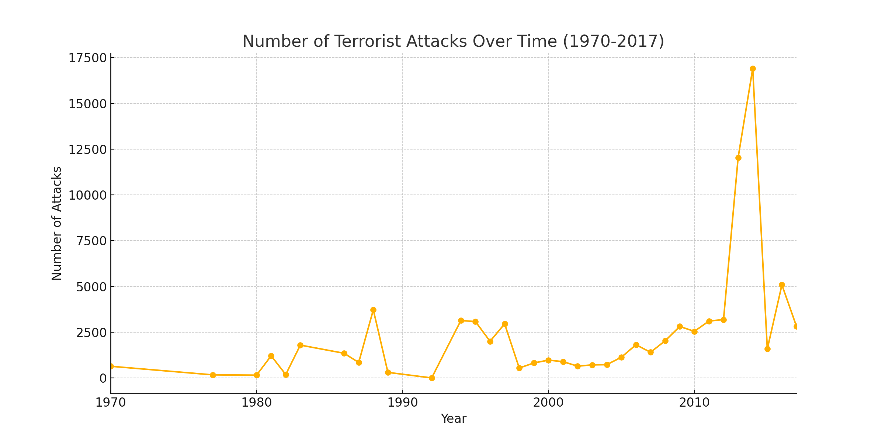
Number of Terrorist Attacks Over Time (1970-2017)
This line chart shows the trend in terrorist activities over the years, with a noticeable increase in the number of attacks during certain periods, indicating possible escalation in global terrorism.

Slide 6
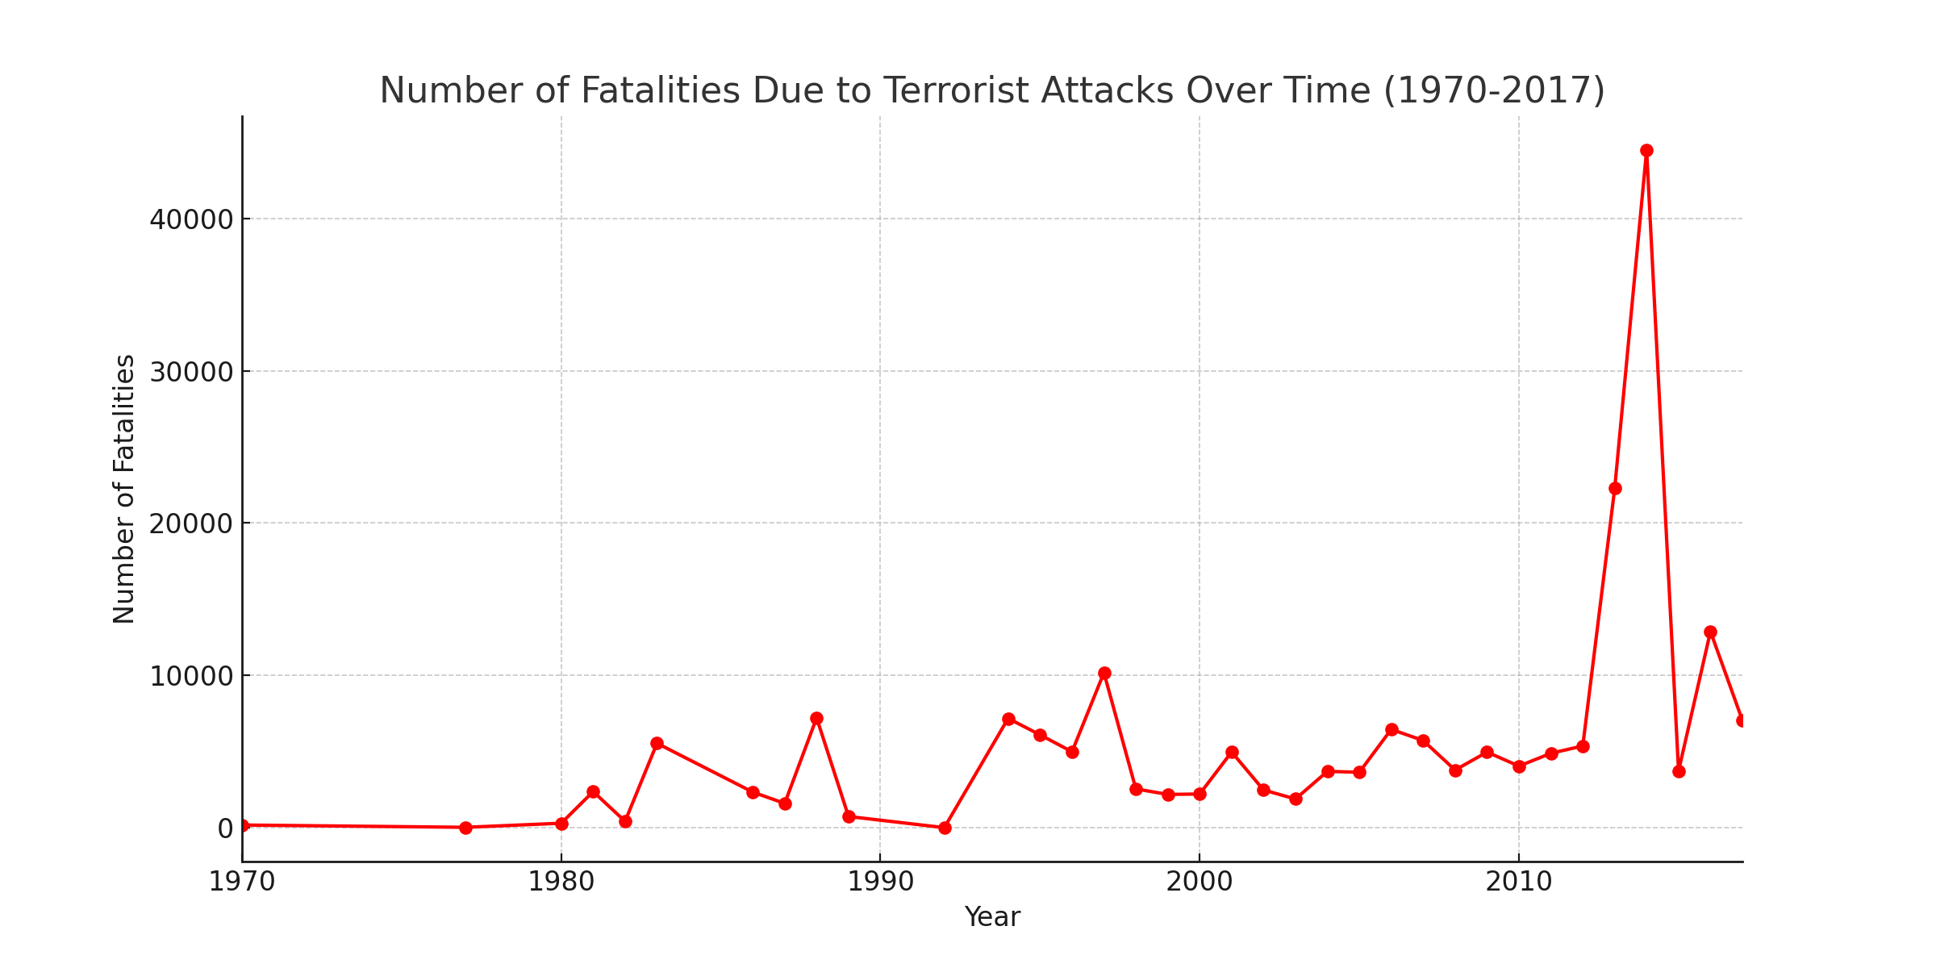
Number of Fatalities Due to Terrorist Attacks (1970-2017)
This chart highlights the trends in fatalities resulting from terrorist activities, providing insight into the deadly impact of these incidents over time.

Slide 7
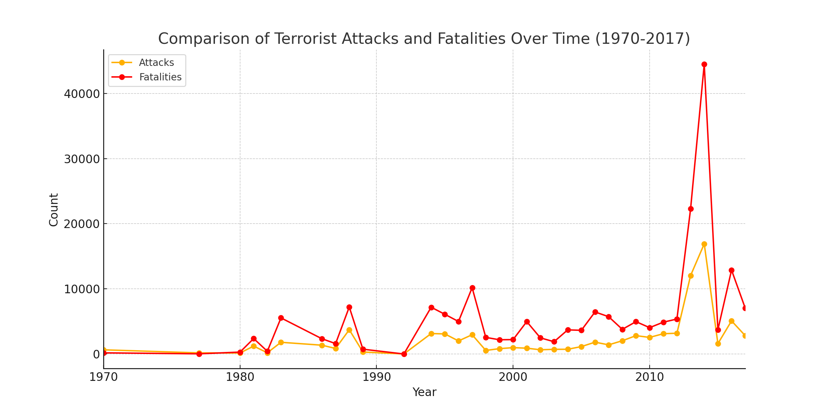
Comparison of Terrorist Attacks and Fatalities Over Time
This comparison reveals that although both the number of attacks and fatalities increase over time, there are periods where the rate of attacks significantly exceeds the rate of fatalities, possibly indicating changes in attack strategies or countermeasures.

Slide 8
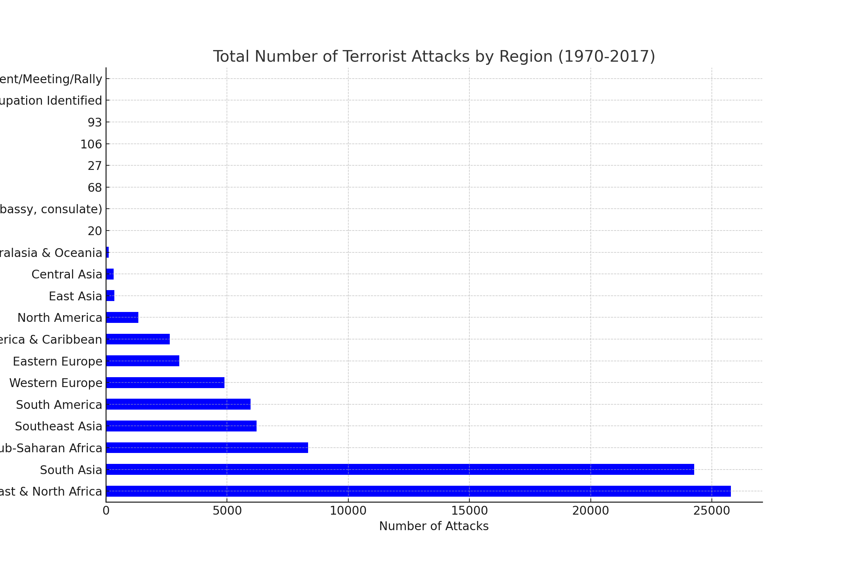
Total Number of Terrorist Attacks by Region
This bar chart shows the distribution of terrorist activities across different regions, highlighting the areas most affected by terrorism between 1970 and 2017.

Slide 9
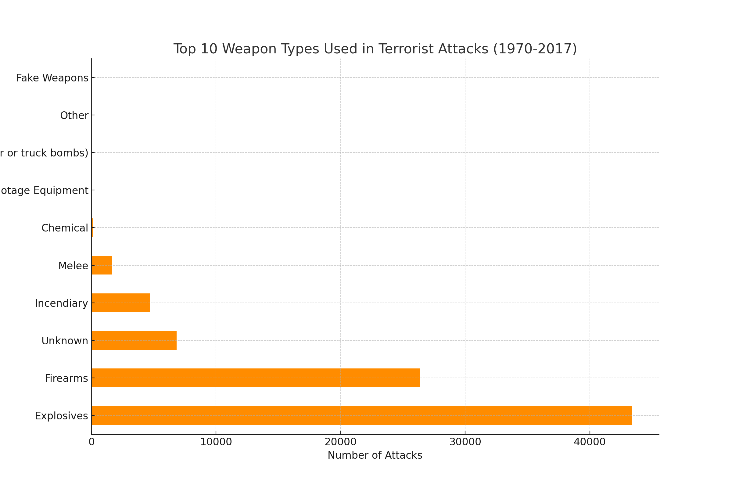
Top 10 Weapon Types Used in Terrorist Attacks (1970-2017)
This bar chart highlights the most commonly used weapons in terrorist incidents, providing insight into the methods favored by attackers over the years.

Slide 10

Key Findings
1. The number of terrorist attacks has significantly increased in certain periods, particularly from the late 1970s to the mid-1990s.
1
2. The Middle East and South Asia are the regions most affected by terrorist activities, with a large concentration of incidents.
2
3. Explosives are the most commonly used weapons in terrorist attacks, indicating a preference for high-impact methods.
3

Slide 11
Conclusions
Based on the analysis of the data, the following conclusions can be drawn:
1. Terrorism has become more prevalent and deadly over the years, especially in certain regions.
2. The consistent increase in attacks suggests that counterterrorism efforts may need to be intensified, particularly in regions like the Middle East and South Asia.
3. Further research is necessary to understand the underlying causes driving these trends and to develop more effective preventive measures.

